Slide 1
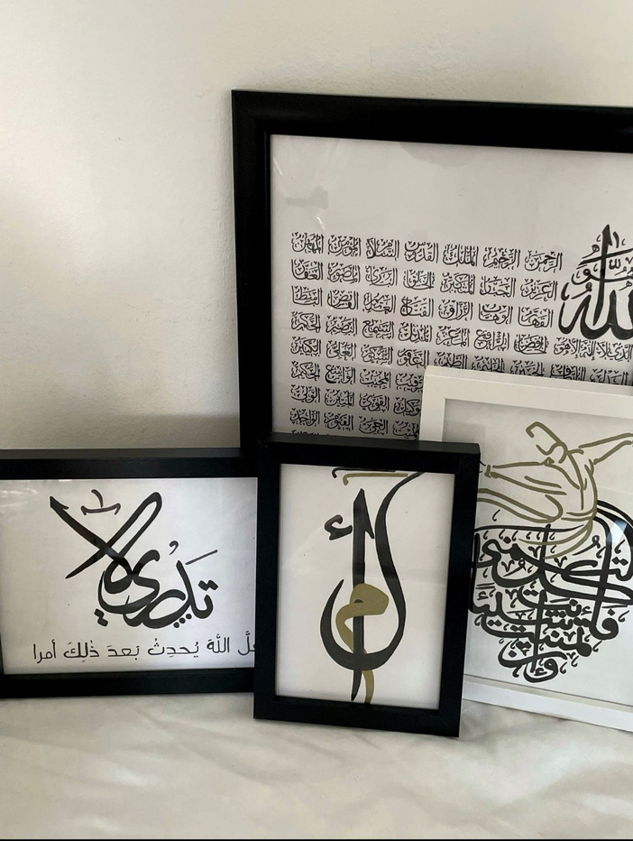

Art Planet

Slide 2
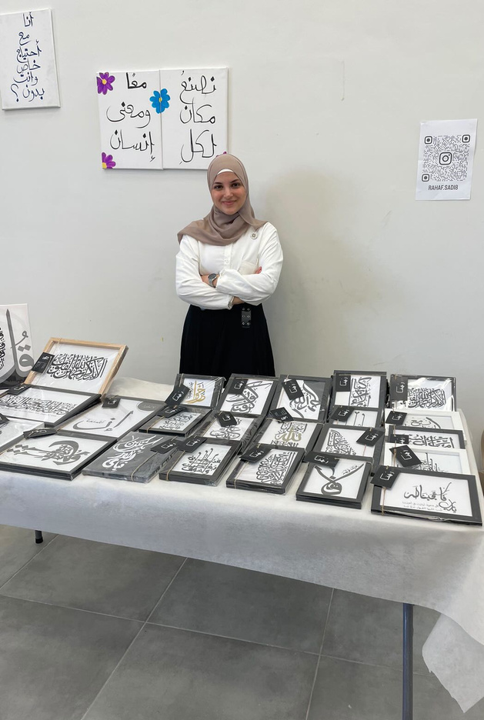
About the Owner
R.S
ART PLANET IS A SMALL BUSINESS OWNED BY RAHAF, A REMARKABLE ARTIST. RAHAF DISCOVERED HER PASSION FOR DRAWING IN 2012 AND HAS SINCE REFINED HER TALENT. BEGINNING WITH A SIMPLE, DETAIL-LESS DRAWING, SHE EMBARKED ON SELLING HER ARTWORK AND STARTED WORKING WITH CANDLES. AFTER CREATING A CALLIGRAPHY PAINTING AND OBSERVING A HIGH DEMAND FOR IT, RAHAF SPECIALIZED IN THIS FIELD. IN ADDITION TO CREATING, RAHAF HAS BROADENED HER EXPERTISE WITH AN ART THERAPY CERTIFICATION AND KNOWLEDGE OF ART HISTORY. HER TEACHING EXPERIENCE SPANS A WIDE RANGE OF AGES, COVERING VARIOUS DRAWING TECHNIQUES. CURRENTLY,

Slide 3
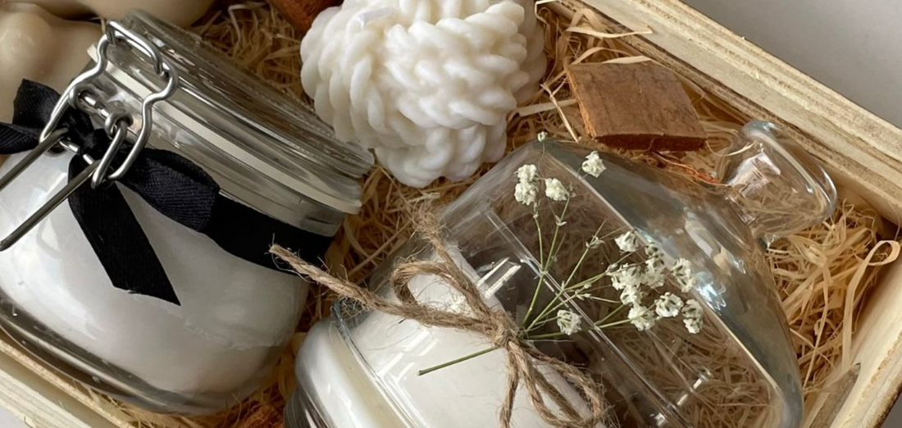
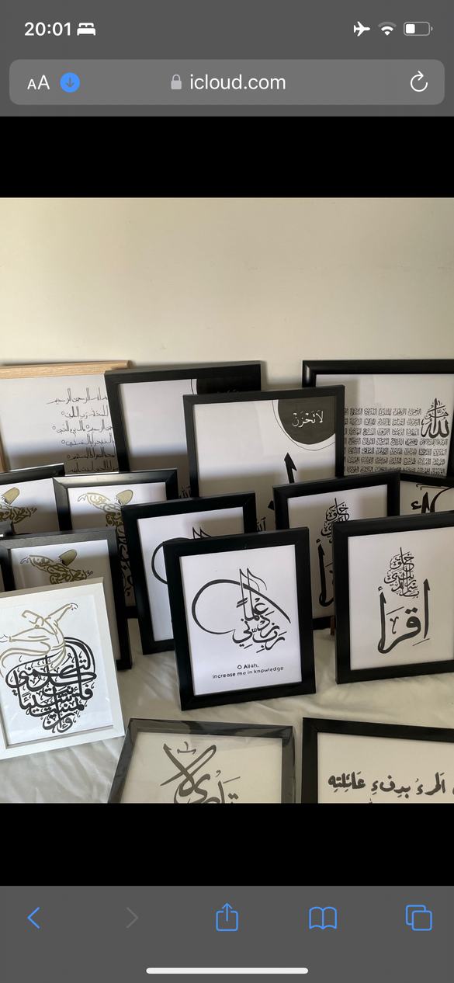
the products of the bussines :
candels .
caligraphy painting .
art courses .
workshops
Currently, she focuses
on calligraphy paintings while also teaching drawing courses.
Therefore, the business offers more than just beautiful creations;
Rahaf also opens her space for workshops and courses. Art Planet is
located in the city of Nazareth.

Slide 4
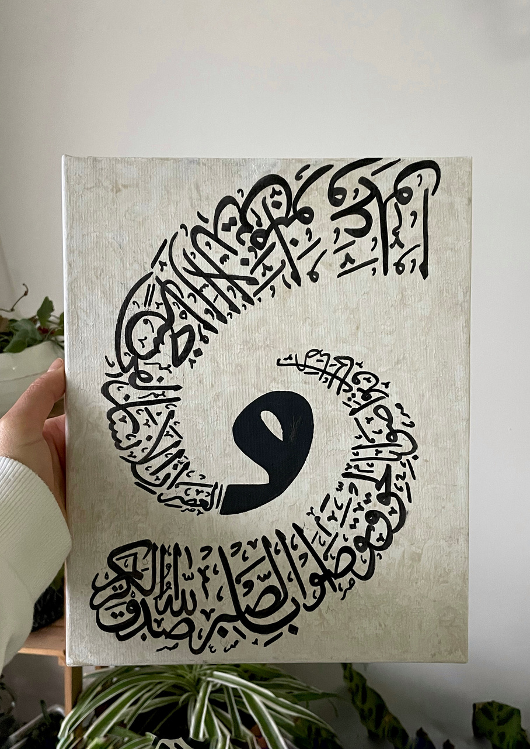
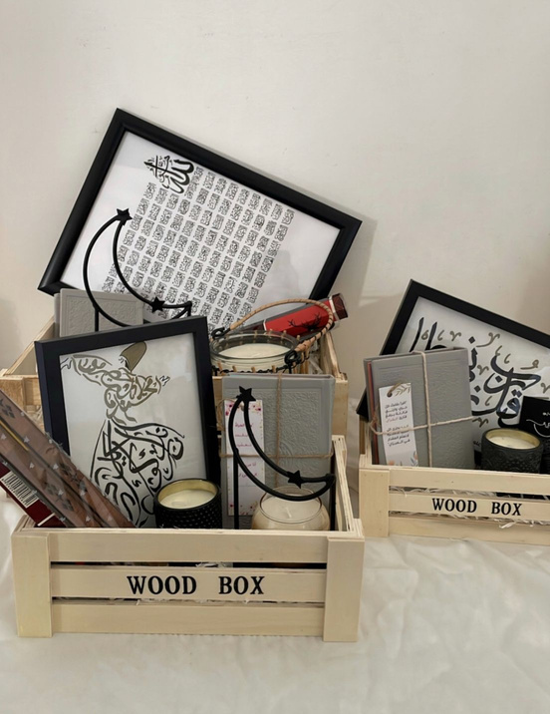
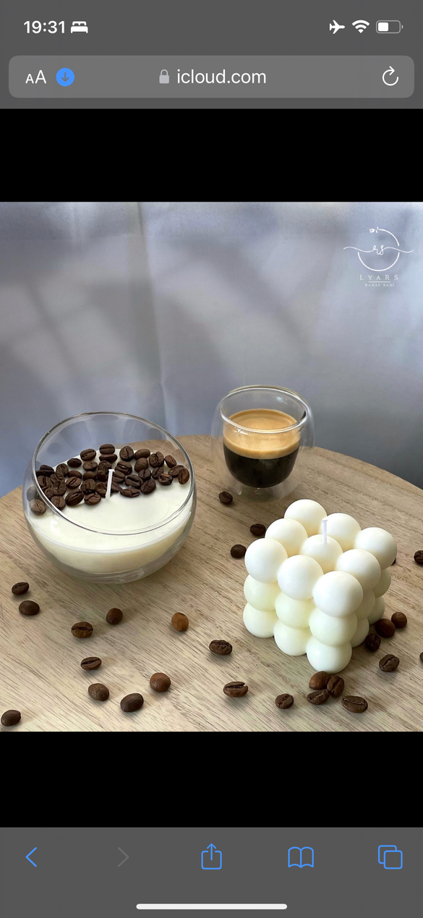
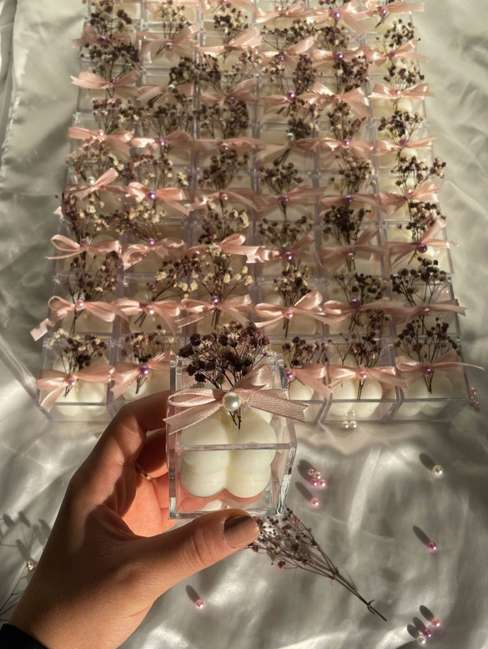
PRODUCTS
2
4
1
3

Slide 5
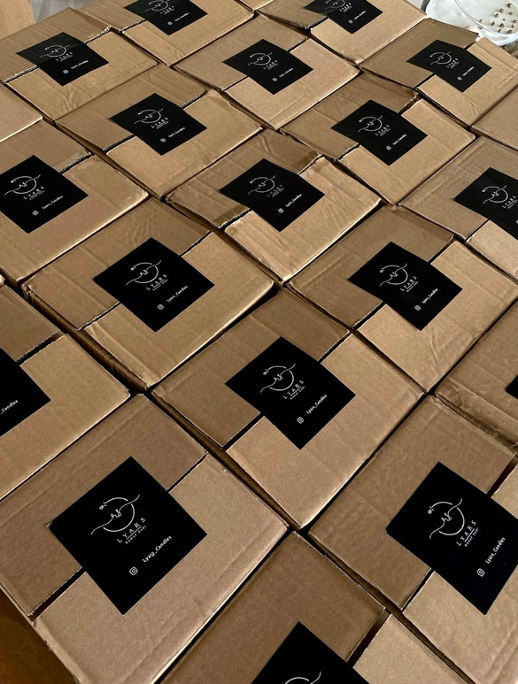
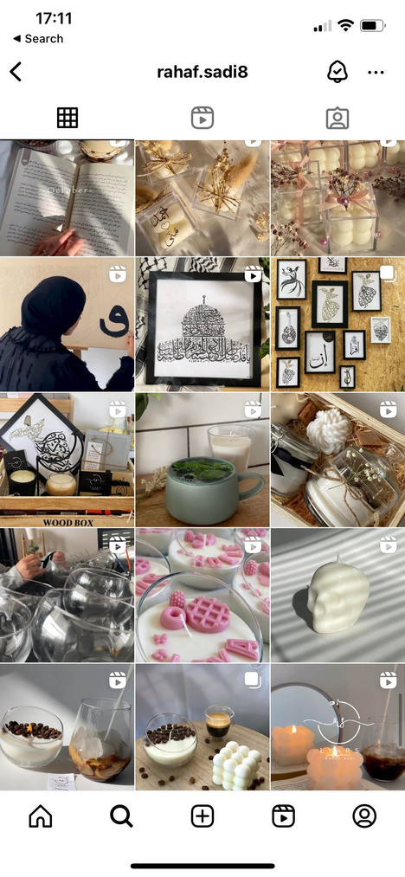

PROBLEM ONE
Problem
Rahaf managed all her orders through WhatsApp or Instagram,
and recorded them in her business journal. However, she often
faced difficulties with ensuring accuracy, as orders would
occasionally have missing items or incorrect products. This led to customer dissatisfaction and adversely impacted her business.
She also dealt with clients who were reluctant to pay after placing their orders or cancelled it. These challenges added to the complexity of managing her business efficiently.

Slide 6

PROBLEM TWO
Problem
Ordering through Instagram was challenging for customers. Most prefer to find products with a clear description and price. They dislike dealing with questions and a lot of messages, they opting to see all details upfront and place orders with minimal hassle.
A Misunderstandings between customers and Rahaf during texting each other , for instance, led to discomfort due to miscommunication.
Add captions to your photos.

Slide 7
Solution 1
To address these challenges, we decided to create
an e-commerce website featuring both a client
interface and an administration panel.
On the admin side,
We developed a comprehensive admin system to assist Rahaf in managing her business data effectively. She can now receive all the orders , product , courses in a structured table format, which allows her to add, update, and delete data related to her business. This system aims to streamline her operations and minimize the issues previously encountered with order accuracy and client communication.

Slide 8
Solution 2
To address these challenges, we decided to create
an e-commerce website featuring both a client
interface and an administration panel.
For the client side,
we developed an e-commerce platform that enables users to register for an account or log in, browse products, and make purchases online seamlessly without the need for back-and-forth messaging. The website also features a section where users can view all the available courses and workshops. This setup is designed to provide a straightforward and efficient shopping experience, removing previous communication barriers and making transactions smoother for both Rahaf and her customers.

Slide 9


Slide 10

Challenges
01
creating two separate but interconnected systems , one for clients and one for the administrator and ensuring they are integrated seamlessly.
02
Building a reliable method to fetch and upload images to our database, using Firebase as our cloud storage solution
03
Managing a large inventory where each product is associated with its own image, and we need to make sure each one is correctly connected to its image.
04
Implementing functionality for adding and updating various data points within the admin panel.

Slide 11
Our website

Slide 12
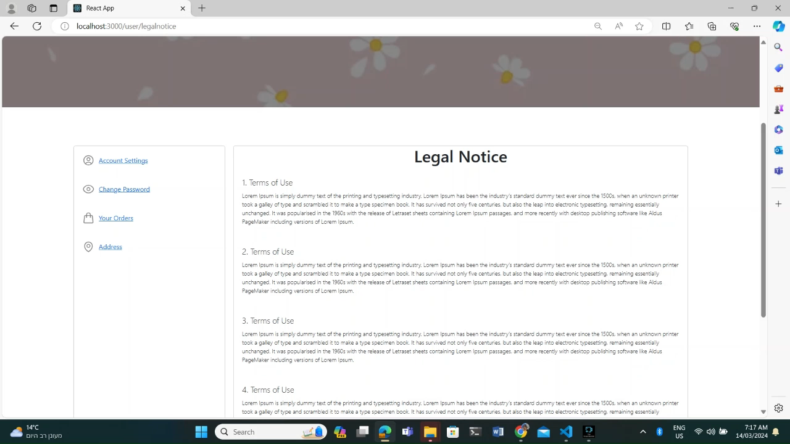


Slide 13


Thank You!

